Slide 1

How to Make A Bootable Flash Drive

Slide 2
How to Make A Bootable Flash Drive
Ubuntu has “Startup Disk Creator” installed by default but it will not create bootable startup disks for all distributions.
Some Ubuntu “flavors” such as Xubuntu do not even have this application installed.
Startup Disk Creator works fine but there are other applications that work just as well if not better.

Slide 3
How to Make A Bootable Flash Drive
UNetbootin
Universal USB Installer
Etcher
Rufus (While it is open source, it works only on Windows)

Slide 4
How to Make A Bootable Flash Drive
In addition to those programs there are some that allow you to create a flash drive that has multiple ISO’s from which you can boot and install.
MultiSystem
Ventoy
MultiBoot USB
YUMI (Your Universal Multi-boot Installer) (Works similar to Universal USB Installer except you can store more than one OS on it.)
Easy2Boot (While primarily a Windows tool, it does support Linux OS’s)

Slide 5
UNetbootin
UNetbootin (Universal Netboot Installer)
Creates bootable USB flash drives
Is a live USB creator
Supports mainstream Linux distributions such as Ubuntu, Fedora, openSUSE, CentOS, Gentoo, Linux Mint, Arch Linux, Mandriva, MEPIS, Slackware

Slide 6
UNetbootin
Install UNetbootin (I used the PPA method)
The one in the repository is lacking some goodies.
sudo apt-add-repository ppa:gezakovacs/ppa
sudo apt update
sudo apt install unetbootin

Slide 7
UNetbootin
Launch UNetbootin from your main menu

Slide 8
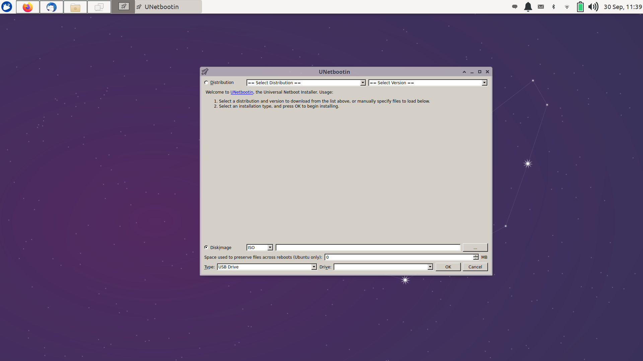
UNetbootin

Slide 9
UNetbootin
There are two ways to create the bootable flash drive: Distribution and Disk Image

Slide 10
UNetbootin
Distribution:
Select a distribution from the drop down menu and then the desired version.
Select an installation type (USB Drive) and then OK to begin installing.
The ISO will then be downloaded and installed to the USB flash drive.

Slide 11
UNetbootin
Disk Image:
Select the ISO which you have already downloaded to your computer
Select the type (USB Drive) and then OK to begin installing

